Slide 1
Axon Simulation

Slide 2
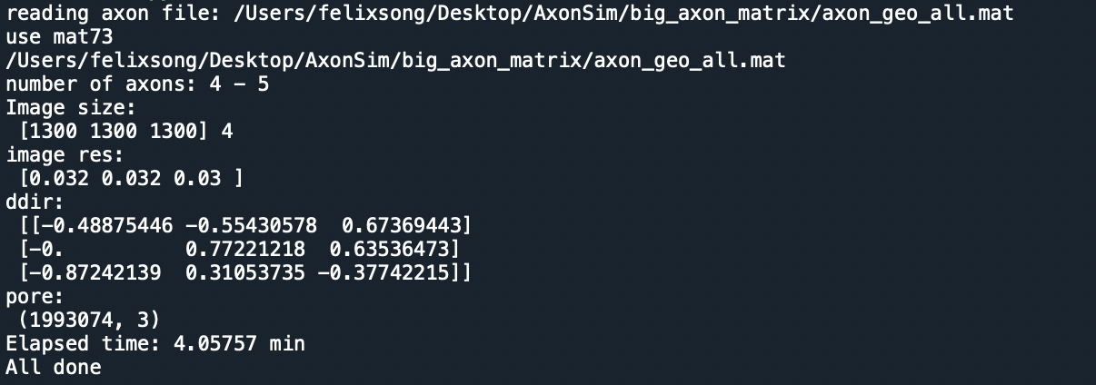
Axon 4

Slide 3
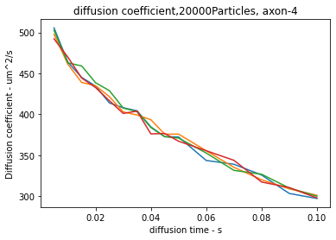
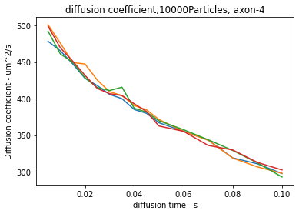
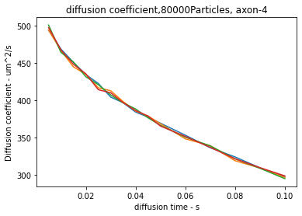
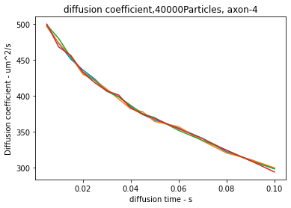
Axon1, index 4

Slide 4
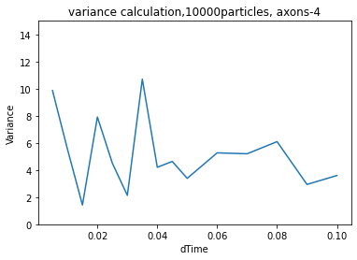
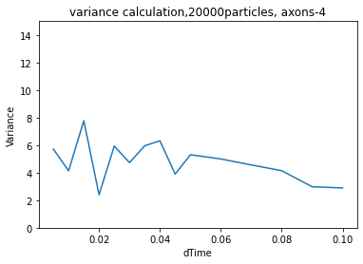
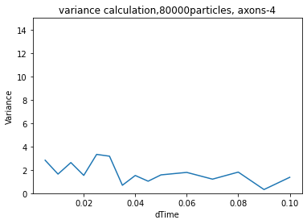
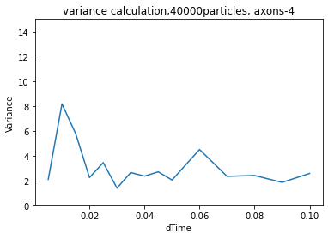

Slide 5
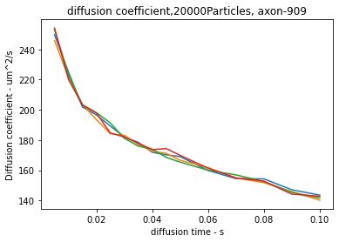
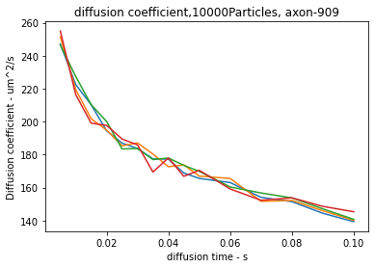
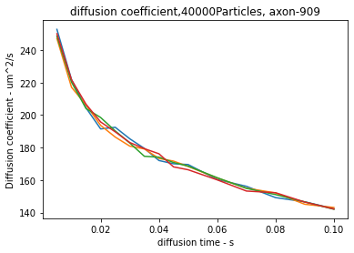
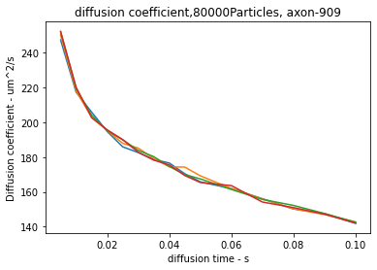
Axon2, index 909

Slide 6
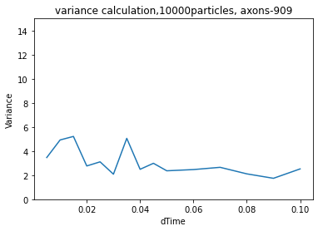
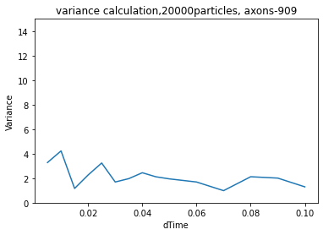
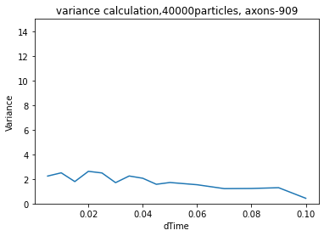
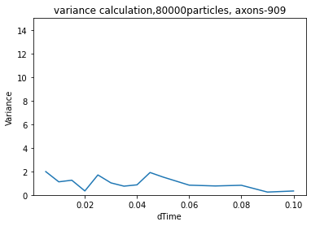

Slide 7
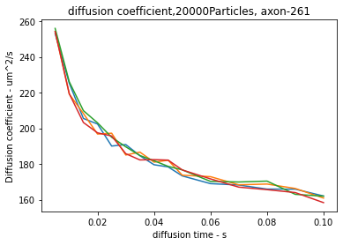
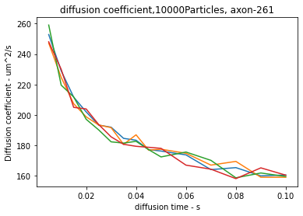
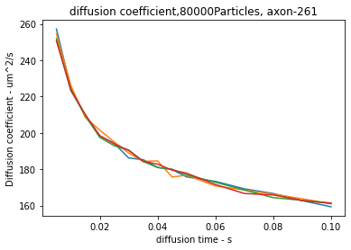
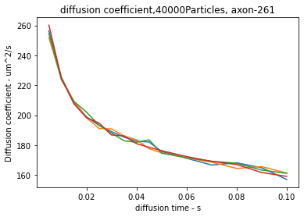
Axon3, index 261

Slide 8
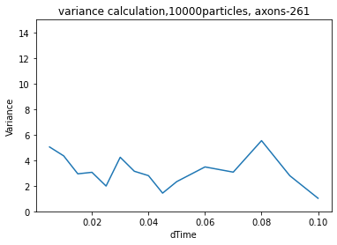
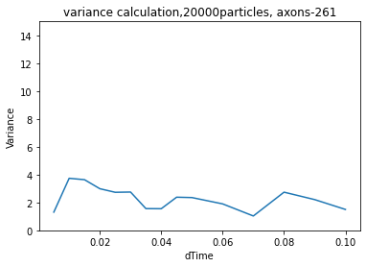
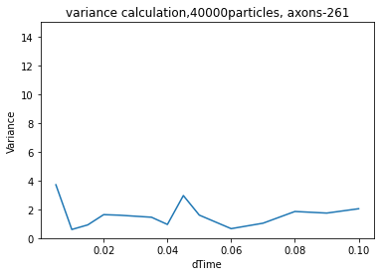
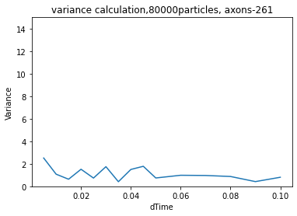

Slide 9
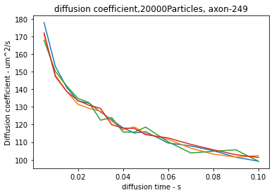
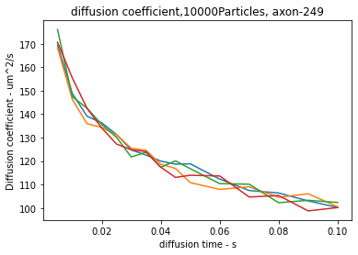
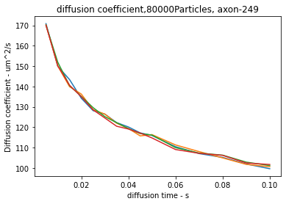
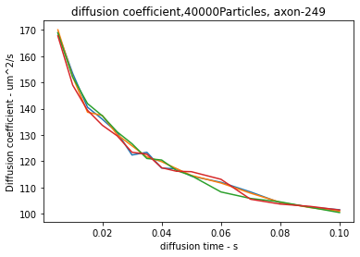
Axon4, index 249

Slide 10
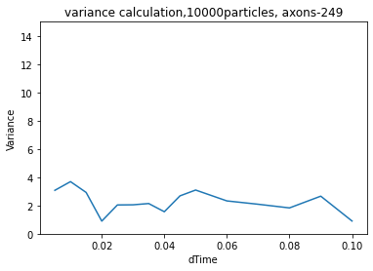
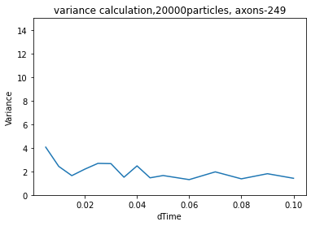
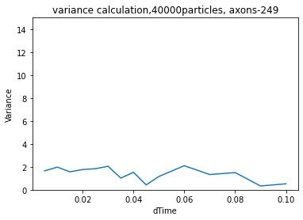
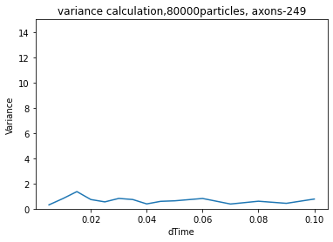

Slide 11
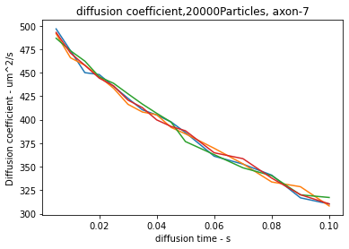
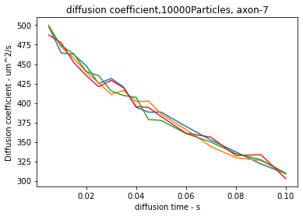
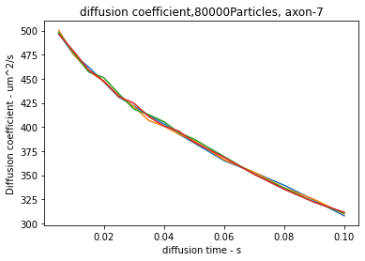
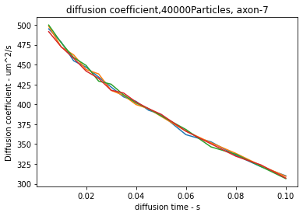
Axon5, index 7

Slide 12
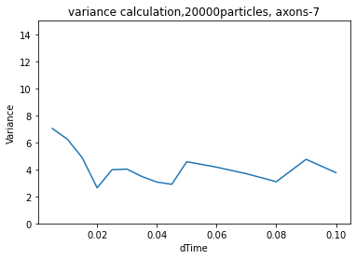
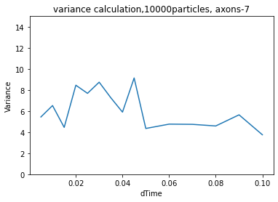
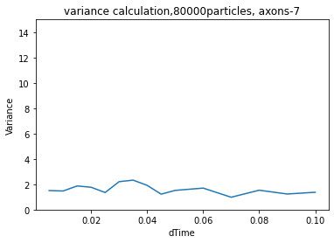
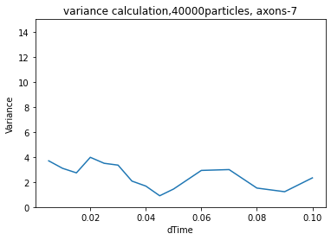

Slide 13
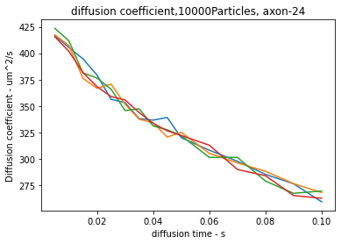
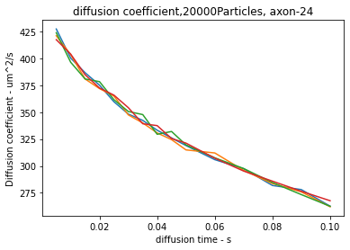
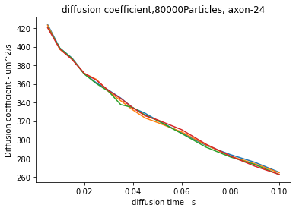
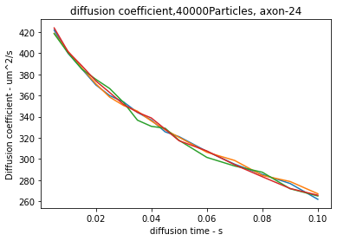
Axon6, index 24

Slide 14
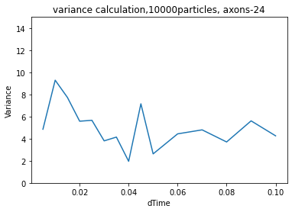
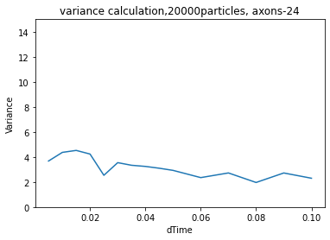
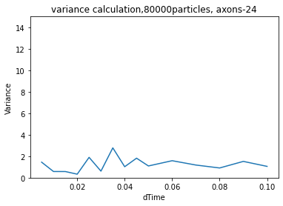
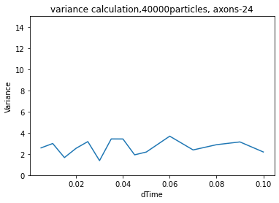

Slide 15
Figure 2

Slide 16
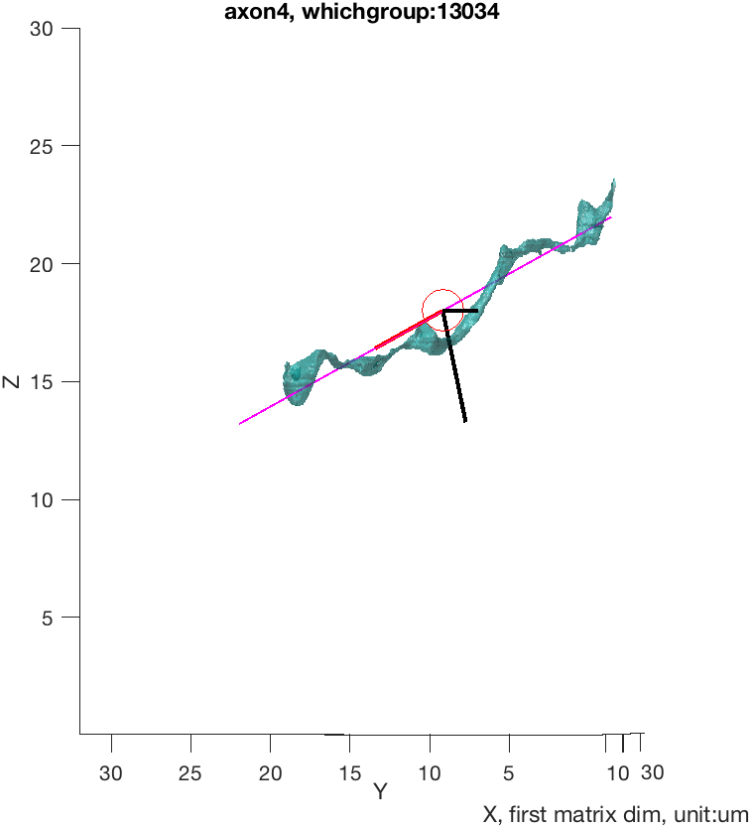

Slide 17




Slide 19





Slide 20





Slide 21





Slide 22





Slide 23





Slide 24
Figure 3: Transverse direction

Slide 33



Figure 1, axon1 - index 4, DC=600, NN= 10000, 20000, 40000

Slide 34



Figure 1, axon2 - index 909, DC=600, NN = 10000, 20000, 40000

Slide 35



Figure 1, axon3 - index 261, DC=600, NN = 10000, 20000, 40000

Slide 36



Figure 1, axon4 - index 249, DC=600, NN = 10000, 20000, 40000

Slide 37



Figure 1, axon5 - index 7, DC=600, NN = 10000, 20000, 40000

Slide 38



Figure 1, axon6 - index 24, DC=600, NN = 10000, 20000, 40000

Slide 39


Figure 1, axon1 - index 4, DC=600, NN= 10000

Slide 41





Slide 42


Figure 1, axon1 - index 4, DC=600, NN= 20000

Slide 44





Slide 45


Figure 1, axon1 - index 4, DC=600, NN= 40000

Slide 47





Slide 48


Figure 1, axon2 - index 909, DC=600, NN = 10000

Slide 50





Slide 51


Figure 1, axon2 - index 909, DC=600 NN = 20000

Slide 53





Slide 54


Figure 1, axon2 - index 909, DC=600 NN = 40000

Slide 56





Slide 57


Figure 1, axon3 - index 261, DC=600, NN = 10000

Slide 59





Slide 60


Figure 1, axon3 - index 261, DC=600, NN = 20000

Slide 62





Slide 63


Figure 1, axon3 - index 261, DC=600, NN = 40000

Slide 65





Slide 66


Figure 1, axon4 - index 249, DC=600, NN = 10000

Slide 68





Slide 69


Figure 1, axon4 - index 249, DC=600
Figure 1, axon4 - index 249, DC=600, NN = 20000

Slide 71





Slide 72


Figure 1, axon4 - index 249, DC=600, NN = 40000

Slide 74





Slide 75


Figure 1, axon5 - index 7, DC=600, NN = 10000

Slide 77





Slide 78


Figure 1, axon5 - index 7, DC=600, NN = 20000

Slide 80





Slide 81


Figure 1, axon5 - index 7, DC=600, NN = 40000

Slide 83





Slide 84


Figure 1, axon6 - index 24, DC=600, NN = 10000

Slide 86





Slide 87


Figure 1, axon6 - index 24, DC=600, NN = 20000

Slide 89





Slide 90


Figure 1, axon6 - index 24, DC=600, NN = 40000

Slide 92





Slide 96


Gaussian fit - axon 4

Slide 97



Slide 98



Slide 99



Slide 100



Slide 101



Slide 102



Slide 103


Note: 50000 particles

Slide 104


Axon 23

Slide 105



Slide 106



Slide 107



Slide 108



Slide 109



Slide 110



Slide 111



Slide 113

Figure three

